Slide 1
Introduction to
The AMOS Project
Dirk Riehle, Univ. Erlangen
AMOS A01
Licensed under CC BY 4.0 International

Slide 2
Course Goals 1 / 2 [1] [2] [3] [4]
To introduce students to agile methods by creating useful open- source software in a team
[1] Professional = ambition + collaboration with external partner
[2] Agile methods = our focus here, specifically Scrum + XP
[3] We teach both overall processes as well as best practices
[4] Useful software is software that has value to someone!

Slide 3
Course Goals 2 / 2
Learning objectives
Gain conceptual understanding and practical skills of using
agile software development methods
software project management tools
software development tools
Learn how to work
with an external stakeholder
in a (student) project team
Project objectives
Develop useful open-source software
Perform a great demo on demo-day!

Slide 4

Industry Partners

Slide 5
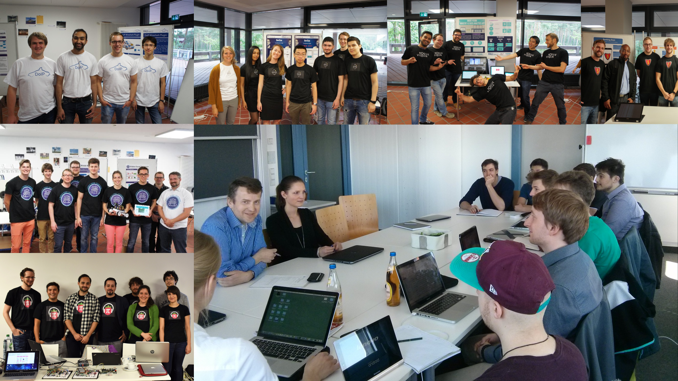

Slide 6
Skills Required for Course
General skills
Willingness and ability to work in a team
Ability to acquire skills during the project
Role-specific skills
Product owner (PO) role
Strong conceptual thinking, ability to communicate well, affinity to technology
Software developer (SD) role
Technology (specific to project), development tools like git, test-driven development
Scrum Master (SM) role
Past successful experience as an AMOS product owner or software developer

Slide 7
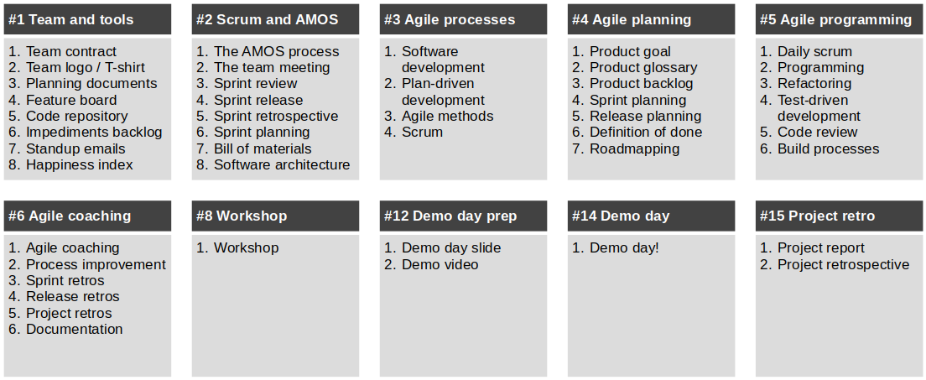
Structure and Content of Course

Slide 8
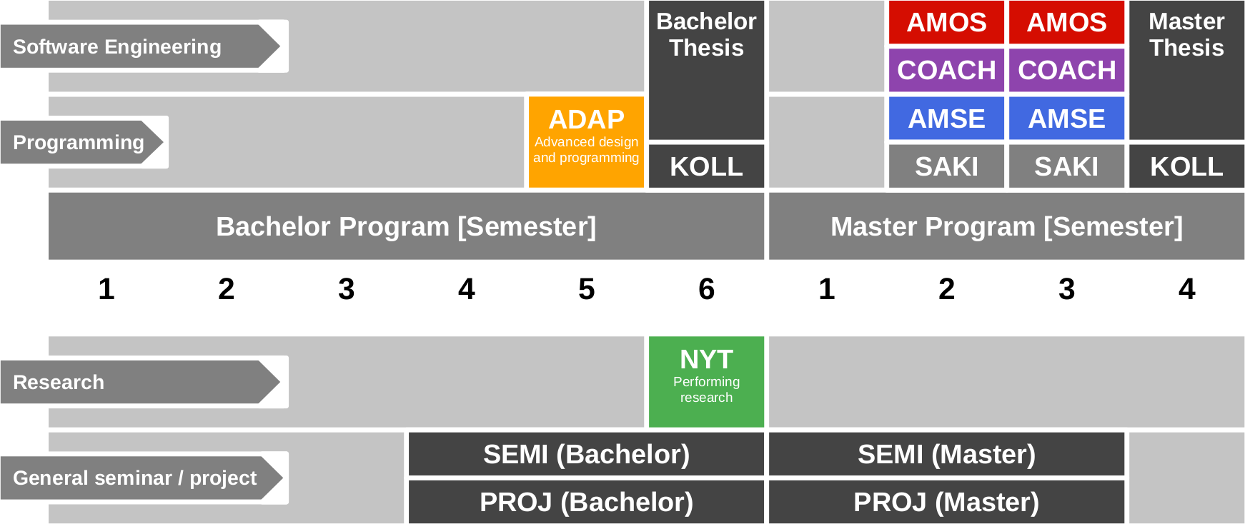
Course Position in Curriculum

Slide 9
Modules and Courses
 |  | Courses (Lehrveranstaltungen)
 |  | AMOS-VL | AMOS-UE (Team Meeting) | COACH-VL | Total ECTS
Modules | AMOS-PO | x | x | – | 5
 | AMOS-SD | x | x | – | 9 / 10
 | AMOS-SM | + | x | x | 3
 | COACH | + | x | x | 5

Slide 10
Availability of Modules
 |  | University
 |  | Univ. Erlangen | TU Berlin | FU Berlin
Modules | AMOS-PO | x | – | –
 | AMOS-SD | x | x | x
 | AMOS-SM | – | x | –
 | COACH | x | – | –

Slide 11
Course Grading [1] by Role (Module)
Product Owner (AMOS-PO)
Theory (lectures) = 20% of grade
2 SWS in 5 ECTS = 20%
As measured by class quizzes
Grading scale is [0..10] points
Practice (project) = 100% of grade
Contribution to teamwork = 50%
As measured in team meetings
Grading scale is [0|1|2|3]
Independent work = 50%
As measured by artifacts
Grading scale is [0|1|2|3]
Software Developer (AMOS-SD)
Theory (lectures) = 10% of grade
2 SWS in 10 ECTS = 10%
As measured by class quizzes
Grading scale is [0..10] points
Practice (project) = 100% of grade
Contribution to teamwork = 50%
As measured in team meetings
Grading scale is [0|1|2|3]
Independent work = 50%
As measured by artifacts
Grading scale is [0|1|2|3]
[1] Also see http://oss.cs.fau.de/teaching/course-resources/grading-schemes-and-scales/

Slide 12
Class Quizzes
Each class session starts with a class quiz
A quiz will test your understanding of last session’s topic
A quiz typically has 5 questions and will last 10 minutes
The overall quiz is graded using [0..10] scheme (10 points in total)
A class quiz will open precisely when class starts
The quiz is administered automatically
It is your job to have reliable Internet access etc.
There is no way to make up for a missed quiz

Slide 13
Collaboration and Grading
We are required to grade you individually
If you collaborate, for example,
by pair programming
by pair designing
you agree to be graded jointly

Slide 14
Course Registration vs. Exam Registration
Step 1: Course registration (German: Kursanmeldung)
Students sign up through the course management system
You may or may not get in, various rules and regulations apply
The earlier you sign up, the more likely you are to get in
Step 2: Exam registration (German: Prüfungsanmeldung)
During the first weeks of the course, you can decide to drop out
Four weeks (or so) into the semester, you can register for the exam
After exam registration closes, your decision is binding

Slide 15
Receiving a Grade for the Course
If you want to receive a grade
You must register through your university’s exam registration system
Your degree program may have split the course into two (VL + UE)
Please check asap that the course is available in your degree program!
In case of problems, please see
https://oss.cs.fau.de/teaching/course-resources/course-registration/
Otherwise: No grade

Slide 16

No Oral or Written Exam [1] [2]
[1] If both you and we don’t want to
[2] You still have to register for the course

Slide 17
Course Language [1]
Class
Lecturer: English
Student: Choice of German or English
Project
Instructor: English
Team: Choice of German or English
[1] See https://oss.cs.fau.de/2012/03/10/english-or-german-deutsch-oder-englisch/

Slide 18
Course Organization
Course organization
See https://amos.uni1.de
Course schedule
See Schedule tab on Course Organization doc
Project descriptions
See Project Descriptions on Course Organization doc
Project teams
See Project Teams tab on Course Organization doc

Slide 19
Work Rhythm
Lectures
Class day (90min.)
Team meetings
Next slot after lecture
Project work (self-organized)
Deliverables due according to schedule

Slide 20
Course Communication
Announcements are sent by email
Through email aliases
Through course management system
Administrative questions to teaching team
Please ask your question in the course forum
For private questions, use the teaching team email alias
Process questions to your Scrum Master

Slide 21
Thank you! Any questions?
dirk.riehle@fau.de – https://oss.cs.fau.de
dirk@riehle.org – https://dirkriehle.com – @dirkriehle

Slide 22
Legal Notices
License
Licensed under the CC BY 4.0 International license
Copyright
© Copyright 2023 Dirk Riehle, some rights reserved

